Slide 1
MCMI-IV Dylan Schouppe Grand Canyon University CNL-644-0500 Professor Kesha Waterman March 22, 2023
Grand Canyon University

Slide 2
Objectives
Explore the Millon Clinical Multiaxial Inventory-IV (MCMI-IV)
Assess relevant legal and ethical considerations
Explore the applicability of the MCMI-IV
Describe relevant treatment strategies
Grand Canyon University
2
Notes:
This presentation will explore the Millon Clinical Multiaxial Inventory-IV (MCMI-IV), including its history, development, and applicability. Additionally, as with any therapeutic inventory or assessment, it is important to consider the legal and ethical implications of administering and applying the MCMI-IV. This presentation will conclude by considering relevant treatment strategies that can be informed by the application of the MCMI-VI.

Slide 3
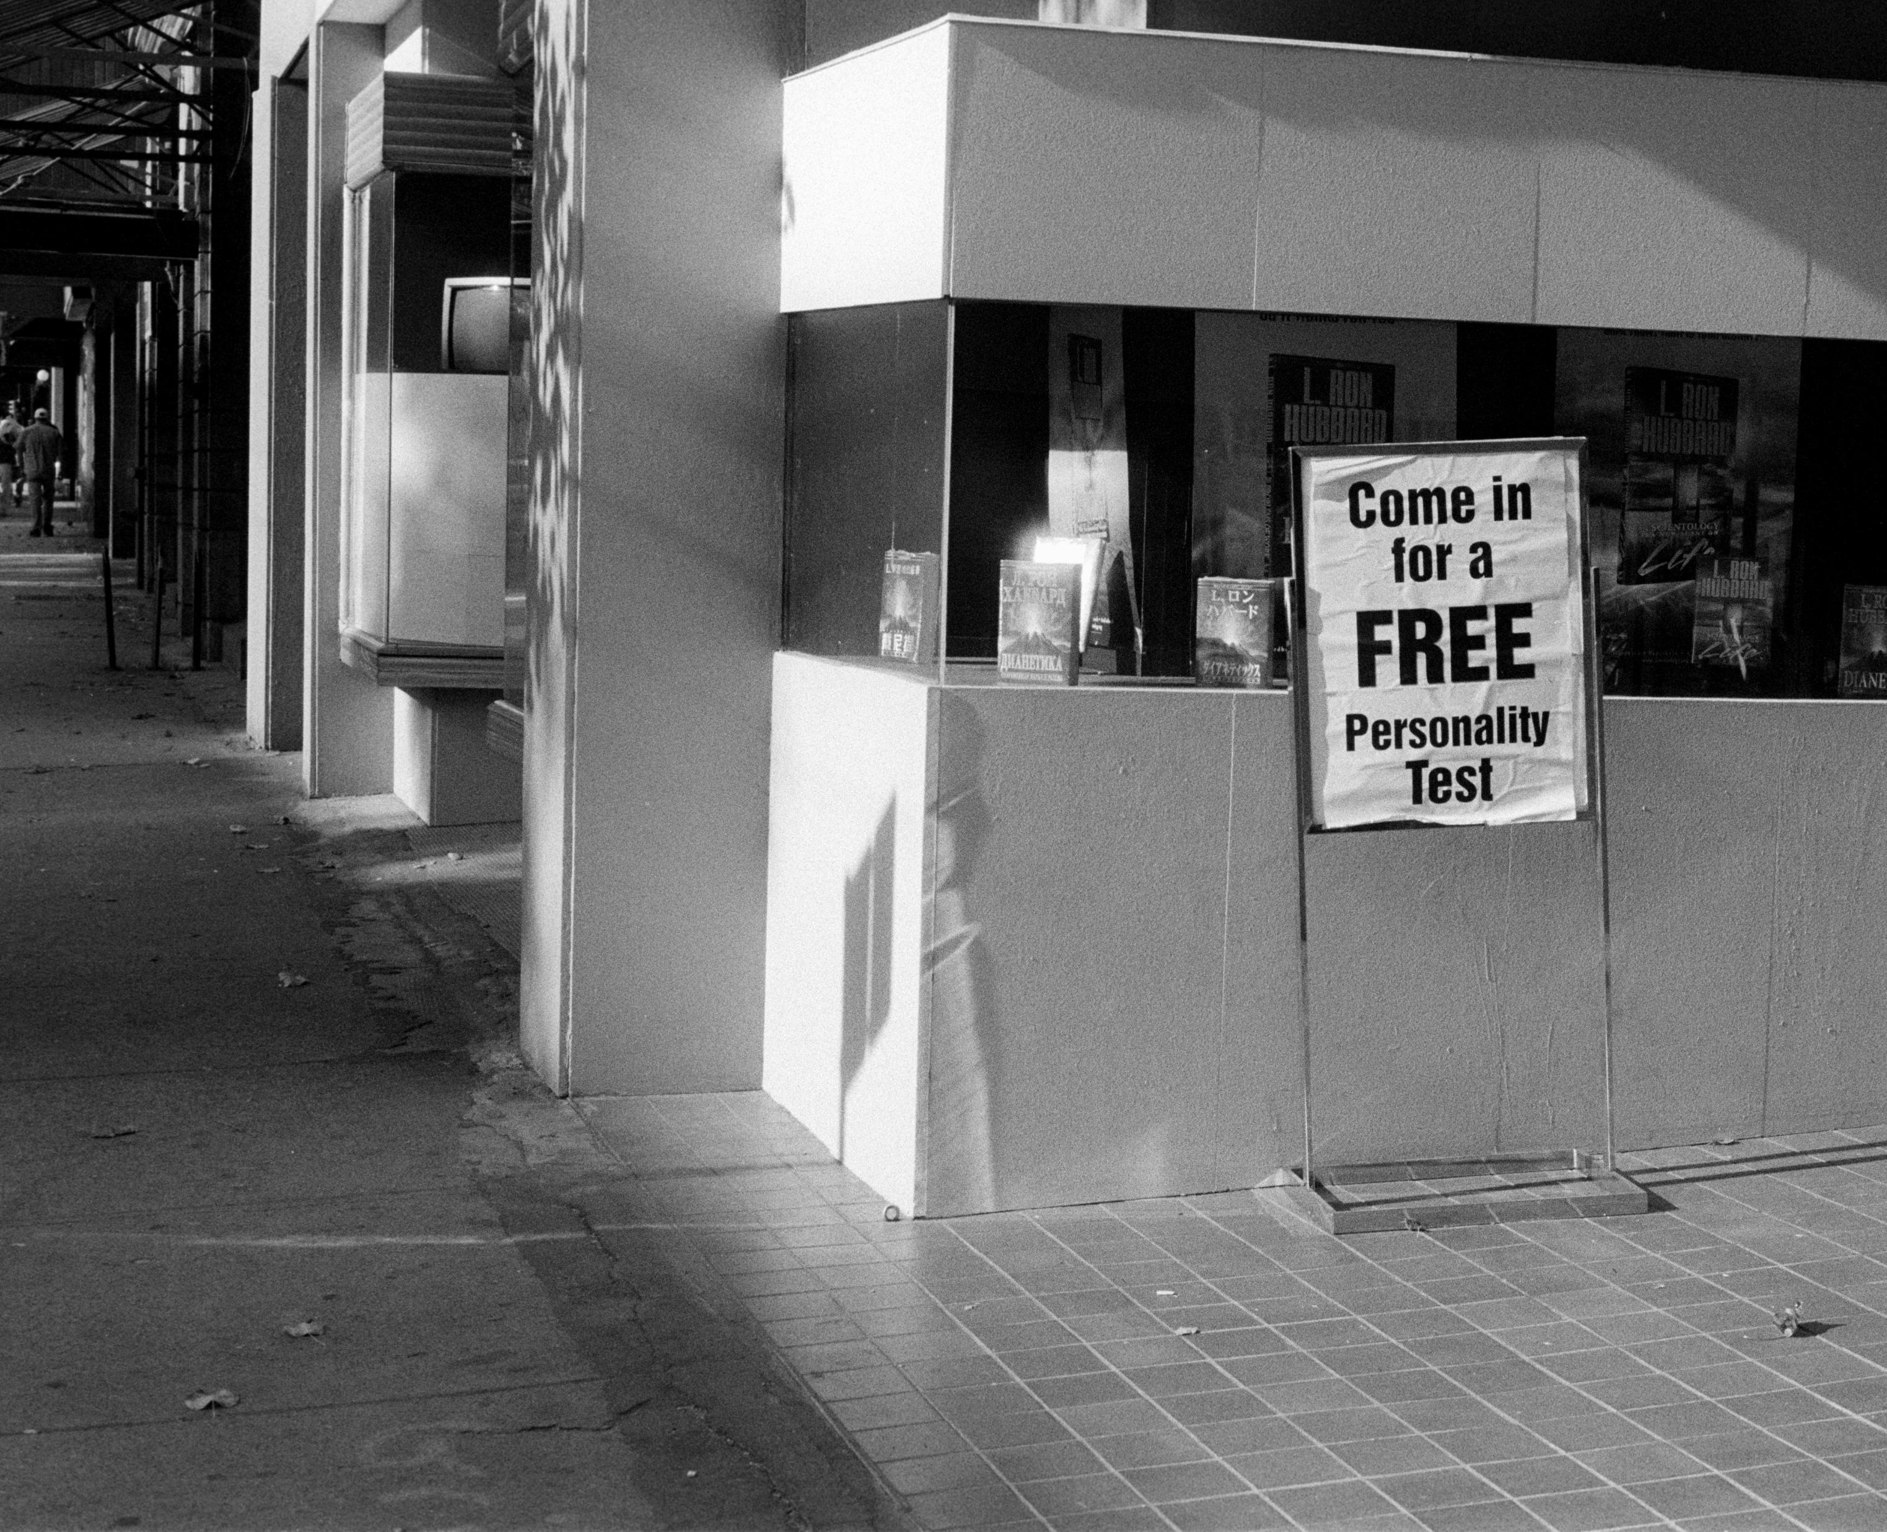
Millon Clinical Multiaxial Inventory-IV
MCMI-IV
Developed by namesake Dr. Theodore Millon
Assesses:
Personality traits
Disorders
Source: Unsplash.com
Grand Canyon University
3
Notes:
The MCMI-VI is a standardized, self-report questionnaire that measures a patient’s personality dynamics (Groth-Marnet & Wright, 2016). The questionnaire was developed by Dr. Theodore Millon; its first iteration appeared in 1977 and records of uses and limitations contribute to future iterations (Millon, 1992). The fourth iteration, its most current, was published in 2019. In measuring specific personality dynamics, it can help detect personality disorders.

Slide 4
MCMI-IV
Source: Unsplash.com
Comprehensive yet approachable
True/false format
195 items
Grand Canyon University
4
Notes:
The MCMI-IV is presented in true-or-false format. Though its relatively sizable at 195 questions, it is easy to navigate. It can be used on individuals 18 years or older in a clinical setting and can be understood by any individual with at least a fifth-grade reading level (Groth-Marnet & Wright, 2017). It usually takes less than 30 minutes to complete, which allows it to be easily administered in a single sitting. It’s available in both English and Spanish. It’s intended to be used in clinical settings.

Slide 5
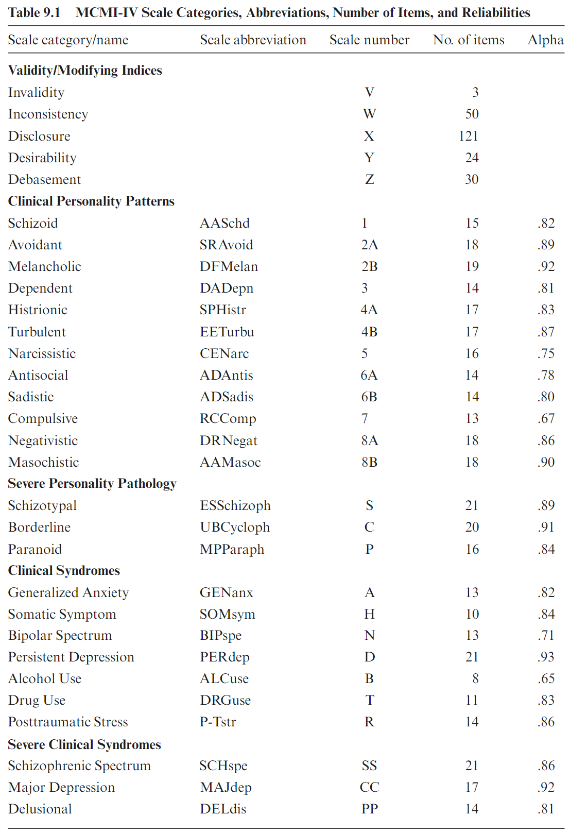
Personality Dimensions
Specific dimensions of personalities
Validity and Modifying Indices
Clinical Personality Patterns
Severe Personality Pathology
Clinical Syndromes
Severe Syndromes
Rooted in Millon’s theory of personality
Source: Groth-Marnet & Wright, 2019, p. 418
Grand Canyon University
5
Notes:
The specific areas of personality that the MCMI-VI measures include: Validity and Modifying Indices, Clinical Personality Patterns, Severe Personality Pathology, Clinical Syndromes, and Severe Syndromes (Groth-Marnet & Wright, 2016). The assessment is rooted in Millon’s theory of personality, which postulates that personality plays a significant role in an individual’s overall mental wellness (Grossman, 2019). The role can manifest a positive or negative impact, as influenced by the individual’s personality traits.

Slide 6
Applicability
Source: Unsplash.com
Disorders
DSM-V
ICD-10
Findings integrate with action-items
Grand Canyon University
6
Notes:
The assessment’s use of five domains helps practitioners narrow in on specific problematic domains. When applicable, these domains are likely to correspond with a disorder listed in the current Diagnostic Statistics Manual and detailed in the ICD-10 classification system (Grossman, 2019). Individualized treatment plans can be insightfully developed using these findings (Dozer et al., 2020).

Slide 7
Applicability (cont.)
Source: Unsplash.com
Diagnostic criteria matters
Findings integrate with action-items
Grand Canyon University
7
Notes:
Alternatively, rather than meeting a straightforward diagnosis, it can highlight problematic traits that can become the focus of treatment. Not every individual that takes this assessment will necessarily meet criteria for a diagnosis in that domain. Millon’s concept considers personality as set of patterns of behavioral and interpersonal actions; not every set of patterns will be drastic enough to rise to a diagnostic level (Winarick, 2019).

Slide 8
Applicability (cont.)
Diagnosis versus tendency
Treatment is not tied to a specific diagnosis
Source: Unsplash.com
Grand Canyon University
8
Notes:
For example, a person displaying anti-social tendencies may be facing difficulties empathizing with others and finding standing in their community; this same person may not meet the specific diagnostic criteria for anti-social personality disorder. This assessment can be used to discern this, thereby highlighting a more specific treatment path (Groth-Marnet & Wright, 2016). This means that treatment is not necessarily tied to a specific diagnosis.

Slide 9
Why It Matters
Source: Unsplash.com
Theory of personality
Personality influences behavior, which influences well-being
Grand Canyon University
9
Notes:
A personality is not so much a script for a person’s life, but it is the foundation of a person’s thought and behavior patterns (Jolosky, 2019). In this way, Millon’s theory of personality is an extension of cognitive behavior theory; personality influences behavior, which influences a person’s cognitions and well-being (Marčinko et al., 2021). Adjusting treatment to account for specific personalities can reduce the likelihood that said personality will derail treatment.

Slide 10
Ethical Considerations
Source: Unsplash.com
Counselor competency
Proper tools
Grand Canyon University
10
Notes:
As with all assessment tools, it’s important to consider the ethical considerations of applying this tool. As the American Counseling Association (2014) argues, counselors should be properly equipped and competent before administering a tool. This is not a case learn-as-you-go, as this can place the patient in a danger. While this assessment is standardized and well-researched, utilizing the proper test provided by Pearson, the test’s official publisher, ensures the purity of the tool itself.

Slide 11
Ethical Considerations (cont.)
Consider limitations
Consider bias
Grand Canyon University
11
Notes:
Additionally, a counselor should be aware of the limitations of this assessment. It is an assessment whose primary focus is measuring personality; it should not be used as a tool to measure current emotional status, mental status, or suicidal or homicidal intent. Nor is it a tool that provides every piece of treatment planning. It is intended to guide treatment, not serve as a treatment itself.

Slide 12
Legal Considerations
Source: Unsplash.com
Ethical implications and limitations
Consider context
Grand Canyon University
12
Notes:
Similarly, counselors must consider the legal implications of using this assessment. The aforementioned ethical considerations can themselves provide insight into legal considerations, as a counselor engaging in unethical behavior is legal liable for negative consequences that befall the patient. Use of these tests, or any test, can also be affected the specific context in which it is to administered.

Slide 13
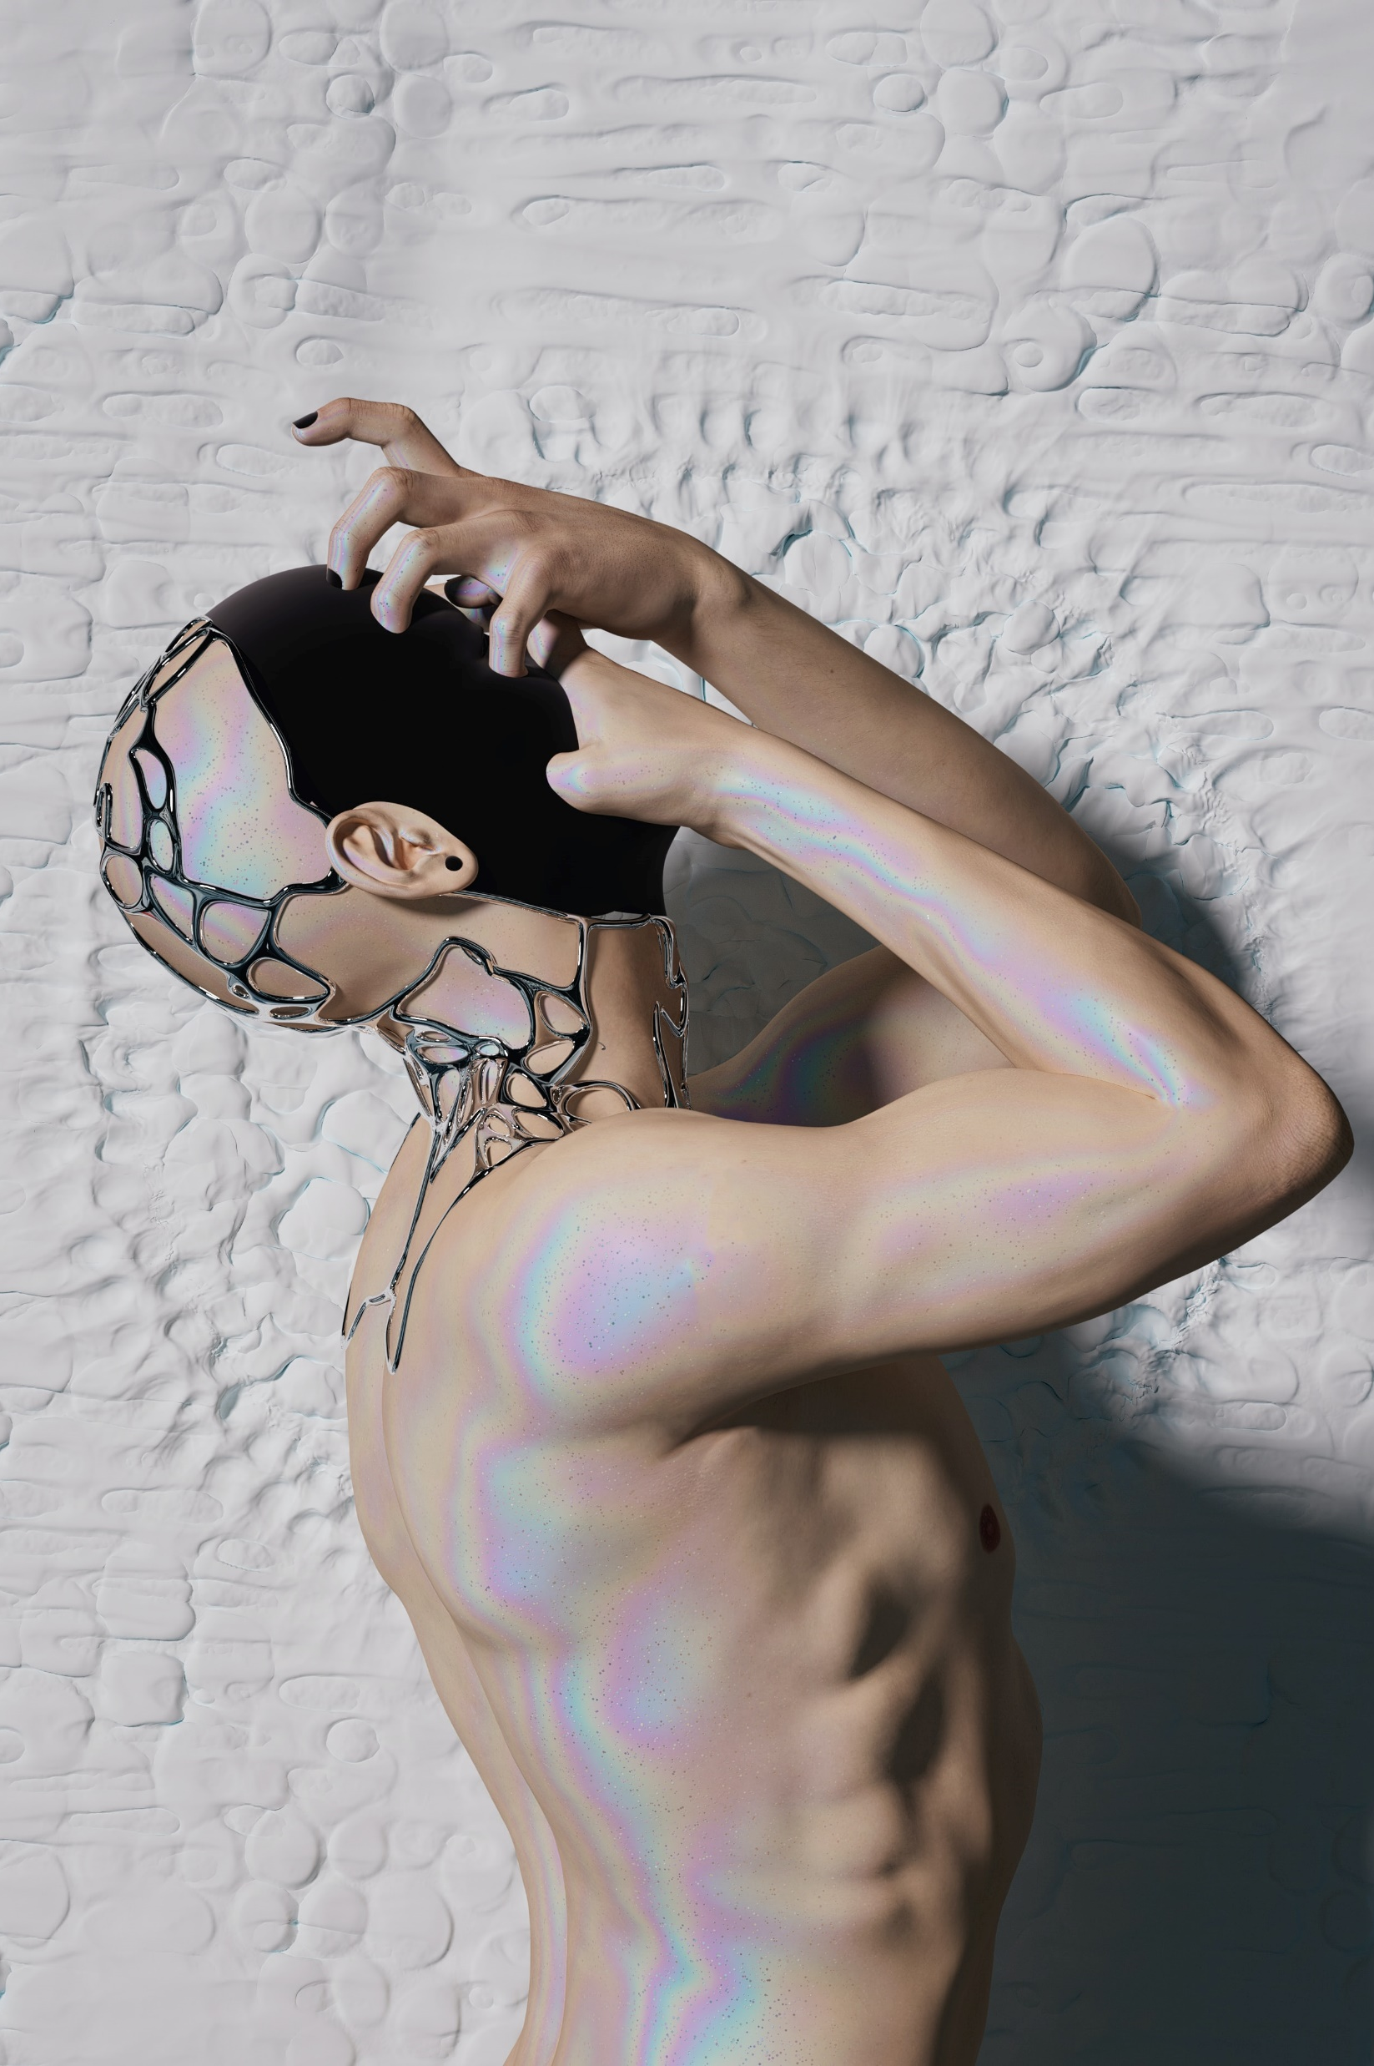
Legal Considerations (cont.)
Source: Unsplash.com
State regulation
Application in legal settings
Grand Canyon University
13
Notes:
The State of Pennsylvania regulates the use of tests within school settings (Mental Health Procedures Act, 1996). Otherwise, there are no specific limitations to a counselor implementing this tool. However, it’s applicability within the legal setting is somewhat controversial. As some of the specific personality domains can provide insight into those with stereotypically violent tendencies (anti-social personality disorder, psychopathy, schizoid personality disorder, et cetera), a counselor’s MCMI-IV may be obtained (or subpoenaed) and used to establish a patient’s behavioral patterns within a forensic context (Sellbom et al., 2022).

Slide 14
Treatment Strategies
Source: Unsplash.com
Specific treatments
Anxiety
Ruminations
Self-defeating thoughts
Grand Canyon University
14
Notes:
The use of the MCMI-IV should be directed toward treatment planning by informing specific treatment strategies. For example, if a patient’s scores suggest tendencies for generalized anxiety, it is appropriate to direct treatment to focus on that. Again, this isn’t being done in a capacity to fix a patient’s personality, per se. The goal should be to mindfully and intentionally supplement a patient’s problematic behaviors, which are influenced by their personality, with more positive, adaptive behaviors. In the case of generalized anxiety, practicing mindfulness techniques and exercising regularly can help impact a person’s anxiety symptoms.

Slide 15
Treatment Strategies (cont.)
Narcissistic Personality Disorder
Belief in one’s superiority
Grandiosity and manipulation
Hoarding disorder
Specific case
Avoidant, dependent, depressive, schizoid
Grand Canyon University
15
Notes:
Another patient may find a higher ranking in their narcissistic personality patterns. This may present with enough significance to inform a narcissistic personality disorder diagnosis. With or without that specific diagnosis, though, treatment can focus on alleviating the inclinations of the personality by supplementing other behaviors and incorporating treatment that can alleviate the maladaptive behaviors that exist due to this personality. Consider, also, the case of those with hoarding disorder. As Dozier et al. (2020) detail, individuals meeting this diagnosis scored high in the avoidant, dependent, depressive, and schizoid scales. While hoarding disorder is, itself, a complex disorder, deconstructing this disorder into four different domains allows a more approachable and sensible form of treatment. This underlying personality structure can inform individualized treatment plans.

Slide 16
Conclusion
Source: Unsplash.com
“We know now that each patient is composed of many sub-parts. The task is to segment out those aspects of a patient's personality style that are troublesome, that create difficulty for them repeatedly.”
-Dr. Theodore Millon
Grand Canyon University
16
Notes:
“We know now that each patient is composed of many sub-parts. The task is to segment out those aspects of a patient's personality style that are troublesome, that create difficulty for them repeatedly" (Pearson Assessment US, 2019, 0:29). There is something extremely intimate in matters of personality. Unlike disease and illness, personality feels exceptionally more personal. When diagnosed with a personality disorder, one may feel inclined to feel like they embodiment the sentiment of disorder and take such a diagnose personally. This should not be the case. The MCMI-IV is one component of treating personality disorders that can empower a troubled individual with better, more apt behavior.

Slide 17
References
American Counseling Association. (2014). 2014 ACA code of ethics. https://www.counseling.org/docs/default-source/default-document-library/2014-code-of-ethics-finaladdress.pdf
Dozier, M. E., Davidson, E. J., Pittman, J. O. E., & Ayers, C. R. (2020). Personality traits in adults with hoarding disorder. Journal of affective disorders, 276, 191–196. https://doi.org/10.1016/j.jad.2020.07.033
Grossman, S. (2019). The Millon Clinical Multiaxial Inventory-IV (MCMI-IV). In M. Sellbom & J. Suhr (Eds.), The Cambridge Handbook of Clinical Assessment and Diagnosis (Cambridge Handbooks in Psychology, pp. 249-262). Cambridge University Press. doi:10.1017/9781108235433.018
Groth-Marnet, G., & Wright, A. J. (2016). Handbook of psychological assessment (6th ed.). Wiley & Sons.
Jolosky, T. (2019). Master of the mind: The voice of Theodore Millon. Tasora Books.
Marčinko, D., Jakšić, N., Šimunović Filipčić, I., & Mustač, F. (2021). Contemporary psychological perspectives of personality disorders. Current opinion in psychiatry, 34(5), 497–502. https://doi.org/10.1097/YCO.0000000000000732
Mental Health Procedures Act 50 P. S. § § 5100 (1996). https://pacodeandbulletin.gov/Display/pacode?file=/secure/pacode/data/055/chapter5100/chap5100toc.html
Millon, T. (1992). Millon Clinical Multiaxial Inventory: I and II. Journal of Counseling & Development, 70(3), 421–426. https://doi.org/10.1002/j.1556-6676.1992.tb01627.x
Pearson Assessment US. (2019, November 1). MCMI-IV by Dr. Theodore Millon. [Video]. YouTube. https://www.youtube.com/watch?v=3BYnwXM_2CQ
Sellbom, M., Flens, J., Gould, J., Ramnath, R., Tringone, R., & Grossman, S. (2022). The Millon Clinical Multiaxial Inventory-IV (MCMI-IV) and Millon Adolescent Clinical Inventory-II (MACI-II) in Legal Settings. Journal of personality assessment, 104(2), 203–220. https://doi.org/10.1080/00223891.2021.2013248
Winarick, D. (2019). Solitary psychopathology: Millon's trait model. Psychology Today. Retrieved March 22, 2023, from https://www.psychologytoday.com/us/blog/personality-quotient/201911/solitary-psychopathology-millon-s-trait-model
Grand Canyon University
17

