Slide 1
Designing Two Interventions Dylan Schouppe Grand Canyon University CNL-545-0500 Dr. Ashley Anne May 4, 2022
Grand Canyon University

Slide 2
Objectives
Identify the best interventions for the listed case studies
Identify local community resources that are available
Explore interdisciplinary treatments and implications
Grand Canyon University
2

Slide 3
Summary of Case Study 1 (Desert Viejo)
Elementary school of 1,200 students from a diverse community
Experienced a school shooting in an administrative office
5 fatalities total, one injured student
Minimal exposure of violence directly to the students, aside from a small group
Grand Canyon University
3
Notes:
The first case study details the events at the Desert Viejo Elementary School, which serves children in kindergarten to sixth grade. This school boasts a population of about 1,200 students and is located in a working-class neighborhood. The neighborhood itself is culturally and racially diverse. One morning, a father of one of the students, distraught over recent custody arguments with his wife, entered the school with an assault rifle and a handgun. The assault rifle was equipped with extended magazine, allowing the father to carry fifty founds of ammunition. Upon gaining access to the school, the father entered the administrative offices and opened fire. He emptied his magazine, killing five people. A group of students were passing nearby, and one student was struck, though their wounds were not fatal. The man killed four people, and then himself. The students passing by at the time were the only students that directly witnessed the shooting. The rest of the school remained in their classrooms, claiming to have heard loud popping noises, crashing, and the sounds of things breaking. The school was placed on lockdown and eventually cleared by local law enforcement.

Slide 4
Critical Incident Stress Debriefing (CISD) Intervention
Critical Incident Stress Debriefing
Helps individuals leverage existing stress response mechanisms
Should occur shortly after traumatic incident
Initiates healing
Source: Unsplash.com
Grand Canyon University
4
Notes:
The case of a school shooting at Desert Viejo Elementary School calls for a Critical Incident Stress Debriefing (CISD) intervention. This intervention, developed in 1983, is intended to help individuals manage normal stress response to considerably abnormal events (Mitchell, et al., 2003). While a school shooting is a regularly occurrence in the United States, it is not a common occurrence to the average individual. Crisis response counselors can implement a CISD, as it is intended to be implement between 24 and 72 hours following the traumatic events. More many, it serves as an effective bridge to the healing process and allows a victim to any traumatic situation to quickly transition into care. However, it does not benefit every participant equally; research is mixed, and Litz (2015) found that CISD did not have any kind of impact on some participants. Such an intervention should be optional, but in such a situation, victims should be encouraged to participate should they need to.

Slide 5
Step-by-Step Implementation of Intervention
Assess the impact of the traumatic event
Identify immediate problems relating to safety
Use defusing techniques
Predict and process aftermath
Conduct review and seek closure
Grand Canyon University
5
Notes:
The CISD was developed and heralded by Mitchell (1983), who explains it as a seven-phase process. The first phase includes an introductory phase with assess the potential impact of the event on survivors, explains the process and confidentiality stipulations, and motivates individuals to participate. The second phase explores of the facts of the situation to identify the existing circumstances as they relate to the safety and trauma; the facilitator can invite the participant to provide a brief overview of the events that happened and how they’re feeling as a result. The third phase is to provide a safe space for participants to discuss the events in order to process their emotions. The fourth phase is to explore possible reactions to the event that may occur further down the road to healing, include forms of PTSD; this allows the participant to plan for future issues and face them head on. The fifth phase is to lead a conversations of the specific symptoms and bring common-occurring symptoms together to form a systemic understanding of the ramifications of the traumatic event. The sixth phase is known as a teaching phase, which aims to normalize the systemic symptoms identified in the previous phase and teach participants how to manage the symptoms. The seventh phase is a re-entry phase, which prepares participants to ask final questions and to hear a summary from the CISD team.

Slide 6
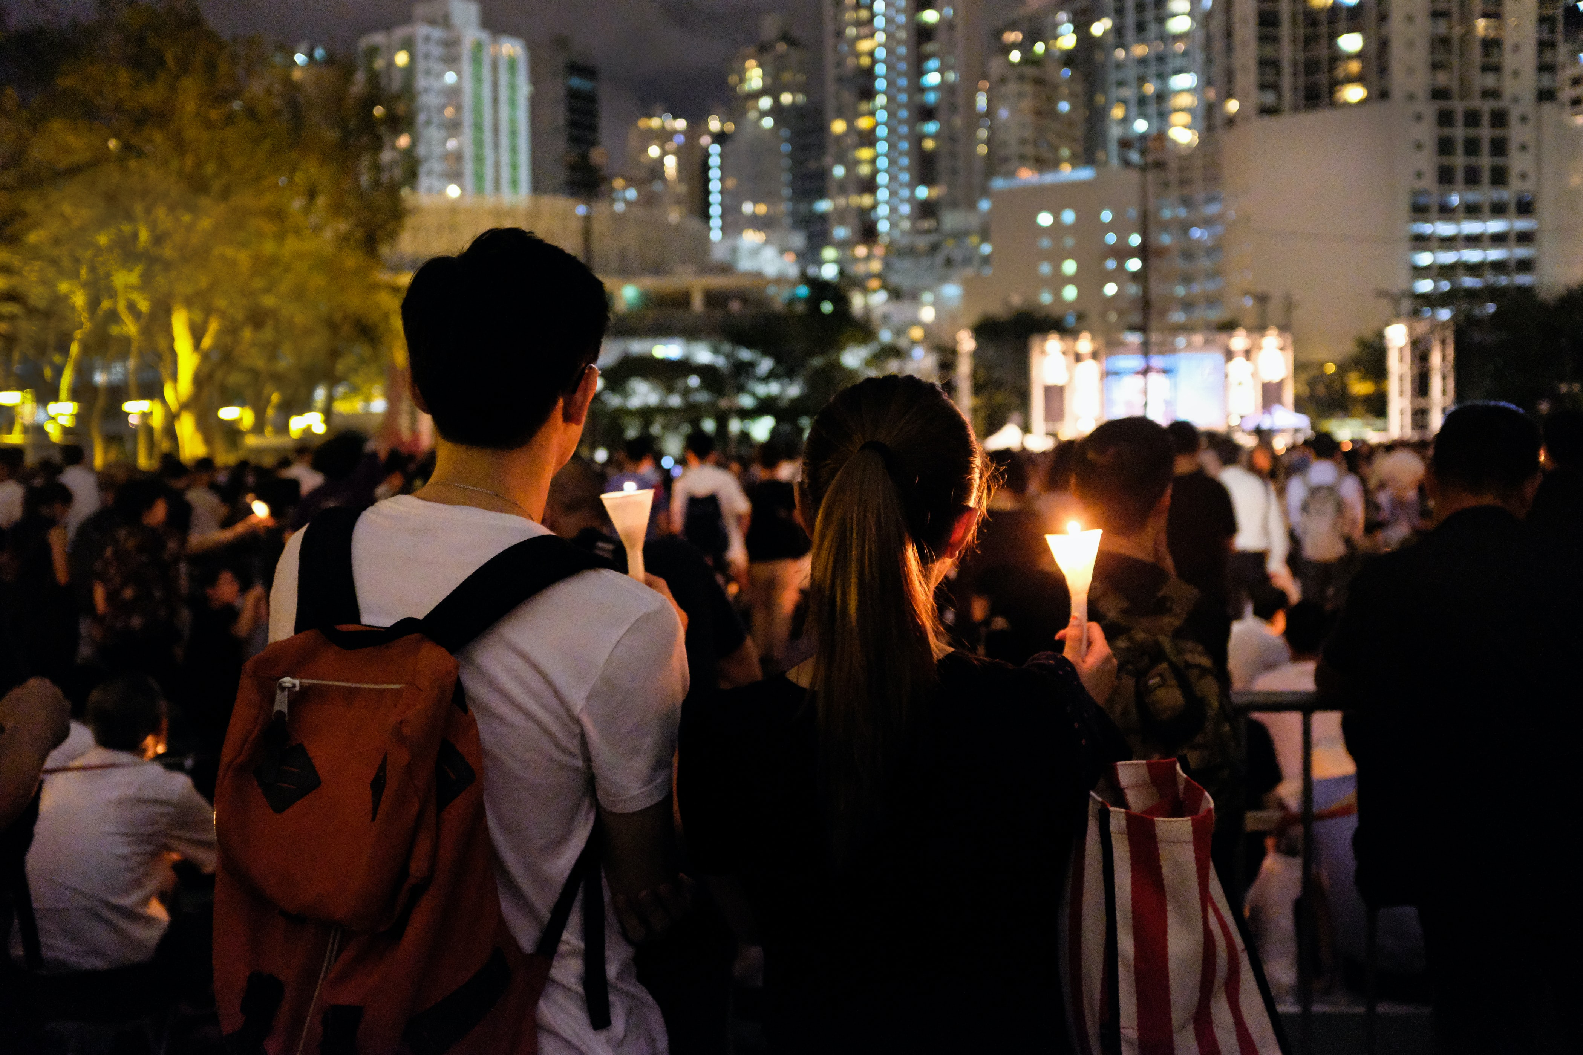
Rationale for Intervention
Quick response
Communal and systemic
Provides clearer path to re-entry and/or continued treatment
Source: Unsplash.com
Grand Canyon University
6
Notes:
The CISD was created specifically to empower clinicians to respond to abnormal, traumatic events. The school shooting is the ultimate traumatic event that is feared by many. The CISD exists to be implemented quickly, and the trauma that can occur as a result of a school shooting merits quick intervention. Additionally, these kind of events do not exist in a vacuum. Entire communities are affected by these tragedies, and the response is also communal in nature. The CISD can be implemented in a group setting, allowing multiple victims to share in their experience in a close-knit setting. The systemic nature also empower local community and government resources to mobilize and respond better to these tragedies, as the CISD respond team create a synthesis of treatment that can be reported/acted on at a later date. Additionally, and perhaps as important as the CISD itself, is that is equips victims to tackle the issue immediately. Some can participate in the CISD and re-enter their life without incident. Others, upon completing the CISD, may realize that they need to seek continuing treatment or additional resources. The CISD can prepare victims for either path.

Slide 7
Community Resources
Online support groups and resources
Forums
Local directories
Local one-on-one and group counseling for low-income
Family Counseling Center, 650 E 4500 S #300, Murray, UT 84107, (801) 261-3500
Utah Behavior Services, 5558 S 1900 W, Salt Lake City, UT 84118, (801) 255-5131
School counselor
National Child Traumatic Stress Network, https://www.nctsn.org/
Medication
Grand Canyon University
7
Notes:
An event like a school shooting affects the entire community. Individuals facing such a traumatic event need to be equipped with this awareness and should be encouraged to seek out available resources, should they need to immediately or later on following the event. There are a number of online resources where victims can seek community and support, including Daily Strength and even Reddit. Reddit has a forum for PTSD where many can find peer-level support. Additionally, some organizations and local agencies have directories for existing support. Psychology Today, for example, has a thorough list of community support, counseling, and group therapy options available. For those without insurance or who are low-income, there are options that include community and subsidized therapy options. Local to Salt Lake City, these can be found at the Family Counseling Center in Murray and Utah Behavior Services in downtown Salt Lake. Many schools are equipped with counselors, and would likely provide additional counselors in the wake of a school shooting. Additional support and resources can be found in the National Child Traumatic Stress Network, which was created by Congress in 2000 as part of the Children’s Health Act. It aims to increase access to services for children and families who experience traumatic events. For those who continue to struggle, medication may be necessary. Pristiq, for example, is highly effective at treating post-traumatic stress disorder; a counselor may need to explore this as an option and include a general practitioner or psychiatrist into the treatment fold.

Slide 8
Summary of Case Study 2 (Joshua)
Teenage Caucasian male, average-performing high school junior
Youngest of four children
Substance abuse disorder patient
Currently on the phone with suicide hotline following recent break up
Grand Canyon University
8
Notes:
The second case study details the situation of one Josh, a 17-year-old Caucasian high school junior living at home with his parents and an older sister (aged 19 years). Josh, who is reported as being an average student in school, is also the youngest of four children. He was hospitalized the previous year for substance abuse disorder. He reports using drugs and alcohol since the age of 12. He is not currently seeking any treatment, though he reports to have made attempts in the past. Previous experiences have made him seemingly wary of therapists, as past providers did not make him feel heard nor understood. He recently experienced a breakup with his girlfriend. He has called the suicide hotline and seems to be in crisis. He feels hopeless and expresses plans to “play in traffic.” He says that he does not see any reason keep living. He has not revealed his current location yet, nor has he revealed whether or not he is currently under the influence of any substances.

Slide 9
Personalized Safety Plan
Immediate implementation
No access to in-person or emergency intervention
Plan to establish immediate safety of individual
Grand Canyon University
9
Notes:
As Joshua is currently in the midst of serious psychological distress, an important intervention is a personalized safety plan. The purpose of such a plan is not to initiate long-term care; rather, it is the address the immediate and ongoing need for a person’s physical safety when facing suicidal ideation or planning. It is a written plan that works as a kind of partnership between a provider a patient (Weinstein, et al., 2021). The plan stacks layers of behavior alternatives to suicide and generally acts according to a person’s level of crisis. For example, the further along a crisis a person is, the further on in the plan the person should be going, up to and including reaching out to professional help and going to the nearest emergency room. It starts out at a relatively high level, identifying and listing warning signs (which signify when the patient could consider the plan) and then detailing coping mechanisms and distracting behaviors. Should suicidal ideation continue, the plan also calls out the individual to list professional resources and encourages to seek them out. It calls on patients to specifically detail a reason or reasons to continue living, which can brainstormed individually or with a counselor.

Slide 10
Step-by-Step Implementation of Intervention
Define safety plan and begin establishing via 6 steps
Identify warning signs
Define coping strategies
Establish social contacts
List family members and friends who can help
List professional medical resources
Make a safe environment
Assess likelihood of the use of the plan
Seek additional care, if necessary
Grand Canyon University
10
Notes:
A safety plan can be implemented quickly, and it is accessible for most patients. A plan that is commonly used is the Stanley-Brown Safety Plan. It consists of six steps (Weinstein, et al., 2021). The first step is to identify warning signs of suicidal ideation or planning, such as specific thoughts, moods, or behavior. The second step is to define internal coping strategies that the individual can rely on, such as meditating, going on a walk, et cetera. The third step is to establish a list of social contacts that can provide a distraction from the suicidal thoughts (but not necessarily provide support or treatment). The fourth step is to list the contact information of family and friends that the individual can reach out, should a crisis start to develop. The fifth step is to list professional agencies and clinicians and their contact information, so that the individual can immediately access these resources once a crisis has developed. The sixth step is to intentionally create a safe environment, which may include removing firearms and sharp objects, leaving a space that is highly elevated and outdoors, et cetera. It’s important to assess the likelihood that a patient will follow this plan, and it is typically necessary to review the plan to ensure its information remains up-to-date and relevant. A safety plan, especially once completed while on the phone with a crisis worker, is necessary but only part of the battle. It helps to ensure safety. It does not begin to treatment the underlying reasons for suicidal ideation. The individual should be encouraged to seek continued, in-person treatment with an established counselor. Additional care may also include group therapy and medication. A counselor may also wish to seek permission from the patient to discuss the issue with other medical providers so that an entire care team, from the counselor to the general practitioner to a pharmacist, is aware of the ongoing suicidal ideation. As medication can sometimes worsen suicidal thoughts, a higher level of interaction and accountability with medical providers can save a person’s life.

Slide 11
Rationale for Intervention
Immediate, direct, and brief intervention
Accessible
Defines reasons to live and coping mechanism
Extends care with additional resources
Grand Canyon University
11
Notes:
As Joshua has called a hotline, the immediate response merits some initial assessment. While there is little to go on, one could assess for the likelihood of the individual acting on their ideation and whether such risk is acute versus chronic (Jackson-Cherry & Erford, 2018). Some hotlines are equipped to track or trace phone calls, or pass calls on to emergency personnel who do have such capability. Should there be a chronic risk of suicide with a high likelihood of immediate death or injury, it would be necessary for emergency services to be sent to Joshua’s location immediately. However, as Joshua has called a hotline to express hopelessness, has not expressed an immediate plan to end his life (instead saying he may “play in traffic soon”), and is responding to clearly defined circumstances (a recent breakup), it’s fair to assume that the risk is moderate to low. A safety plan is the more appropriate response. This will provide Joshua with clear expectations that he keep himself safe, place in on track to keep himself safe, and provide him with access to essential resources that can be sought out should be consider to make himself unsafe. Miller, et al., (2017) found that such brief interventions resulted in an overall decrease in completed suicides, so such an intervention may be enough to keep Joshua safe. Such a plan is also highly accessible, as it can be filled out by hand; there is even an app for the Stanley-Brown Safety Plan, which can be downloaded from Apple’s App Store and allows users to immediately reach out to listed emergency contacts.

Slide 12
Community Resources
Online support groups and resources
Forums
Local directories
Local one-on-one and group counseling for low-income
Family Counseling Center, 650 E 4500 S #300, Murray, UT 84107, (801) 261-3500
Utah Behavior Services, 5558 S 1900 W, Salt Lake City, UT 84118, (801) 255-5131
Local emergency rooms
National Suicide Hotline: 800-273-8255
Localized support: Live On Utah www.liveonutah.org/
Crisis Text Line: Text HOME to 741741
Grand Canyon University
12
Notes:
Again, it is necessary to state that a safety plan is only part of the process, and such a plan requires additional resources that are accessible to a person in a crisis. A person in a crisis may be hindered from seeking support even at the smallest inconvenience or hang up. For those individuals proactively seeking out support, there are a number of online forums and support groups. Similar to the last case study, Reddit is worth mentioning again, as this monitored forum exists to provide communal support, extend access to resources, and is moderated to ensure that grifters and agitators remain out of the forum. Local resources here in Salt Lake provide access to ongoing counseling, and Utah Behavior Services can be accessed for crisis intervention. Worst case, it may be necessary for an individual to know the location of their nearest emergency room, as emergency rooms are equipped to provide immediate assistance. National resources, such as the suicide hotline and the crisis text line, are also necessary. Again, these can be incorporated into the plan itself, but a person in crisis or recovering from a crisis should leverage these resources whenever necessary.

Slide 13
Conclusion
“Trauma is a fact of life. It does not, however,
have to be a life sentence.”
-Peter Levine, Waking the Tiger: Healing Trauma
Source: Unsplash.com
Grand Canyon University
13
Notes:
Psychologist Peter Levine wrote, “Trauma is a fact of life. It does not, however, have to be a life sentence” (1997, p. 3). Many human lives are informed shaped as a result of trauma. While trauma can be a seminal moment that births new understanding and vigor into a person’s life, the resulting struggle and negative ramifications of such trauma do not be inherently ignorable. Indeed, such growth and understanding often only follows despair and pain, and such growth and understanding is not guaranteed as a part of the healing journey. As trauma affects so many people, it is vital that practitioners and counselors remain equipped to treat and assist those who are struggling to endure. Meeting those individuals where they are and providing the safe space necessary to explore their feelings and make sense of the situation (even if there is no sense to be made) can help highlight a path to true healing, even the face of the most horrific of human tragedy and loss.

Slide 14
References
Alvarez, C., Fedock, G., Grace, K. T., & Campbell, J. (2017). Provider screening and counseling for intimate partner violence: A systematic review of practices and influencing factors. Trauma, Violence, & Abuse, 18(5), 479–495. https://doi-org.lopes.idm.oclc.org/10.1177/1524838016637080
Cooper, M. (2003). Existential therapies. Sage Publications.
Davis, E. L., Deane, F. P., Lyons, G. C. B., & Barclay, G. D. (2017). Is Higher Acceptance Associated With Less Anticipatory Grief Among Patients in Palliative Care? Journal of Pain and Symptom Management, 54(1), 120–125. https://doi-org.lopes.idm.oclc.org/10.1016/j.jpainsymman.2017.03.012
Hayes, S. C. (2011). Grief work with acceptance and commitment therapy. American Psychological Association.
Hines, PL & Fields, TH 2002, ‘Pregroup Screening Issues for School Counselors’, JOURNAL OF SPECIALISTS IN GROUP WORK, no. 4, p. 358, viewed 29 July 2021, https://search-ebscohost-com.lopes.idm.oclc.org/login.aspx?direct=true&db=edsbl&AN=RN122681282&site=eds-live&scope=site
Kealy, D., Piper, W. E., Ogrodniczuk, J. S., Joyce, A. S., & Weideman, R. (2019). Individual goal achievement in group psychotherapy: The roles of psychological mindedness and group process in interpretive and supportive therapy for complicated grief. Clinical Psychology & Psychotherapy, 26(2), 241-251. 10.1002/cpp.2346
Klimczuk, A., & Fabiś, A. (2017). Death and Dying, theories of. (pp. 1-7). Scribner.
Kubler-Ross, Elisabeth. 1969. On Death and Dying. New York: Macmillan.
Malkinson, R. (2001). Cognitive-Behavioral Therapy of Grief: A Review and Application. SAGE PUBLICATIONS INC.
Marmarosh, C. L. (2016). Can we collaborate? Mistakes made when group and individual therapists ignore multiple realities. Psychotherapy, 53(3), 320–324. https://doi-org.lopes.idm.oclc.org/10.1037/pst0000067
Mulligan, E. A., & Karel, M. J. (2018). Development of a Bereavement Group in a Geriatric Mental Health Clinic for Veterans. Clinical Gerontologist, 41(5), 445-457. https://lopes.idm.oclc.org/login?url=https://search.ebscohost.com/login.aspx?direct=true&db=edb&AN=131778772&site=eds-live&scope=site
Ramsey-Wade, C. (2015). Acceptance and commitment therapy: An existential approach to therapy? Existential Analysis, 26(2), 256-269. https://lopes.idm.oclc.org/login?url=https://search.ebscohost.com/login.aspx?direct=true&db=psyh&AN=2015-35786-005&site=eds-live&scope=site
Ritchie, M. H., & Norris Huss, S. (2000). Recruitment and screening of minors for group couseling. Journal for Specialists in Group Work, 25(2), 145–156. https://doi-org.lopes.idm.oclc.org/10.1080/01933920008411458
Yalom, D. Y., & Josselson, R. (2014). Existential Psychotherapy. Current psychotherapies (pp. 265–298). Belmont, CA: Brooks/Cole Cengage Learning.
Grand Canyon University
14

