Slide 1
Special Issues with Vulnerable and Older Adults Dylan Schouppe Grand Canyon University CNL-530-0500 Marcie Burger November 17, 2021
Grand Canyon University

Slide 2
Objectives
Explore clinical issues of elder depression from a physical, emotional, cognitive, and spiritual viewpoint
Describe common forms of neglect
Describe warning signs of neglect
Explore legal and ethical considerations of reporting neglect
Grand Canyon University
2

Slide 3
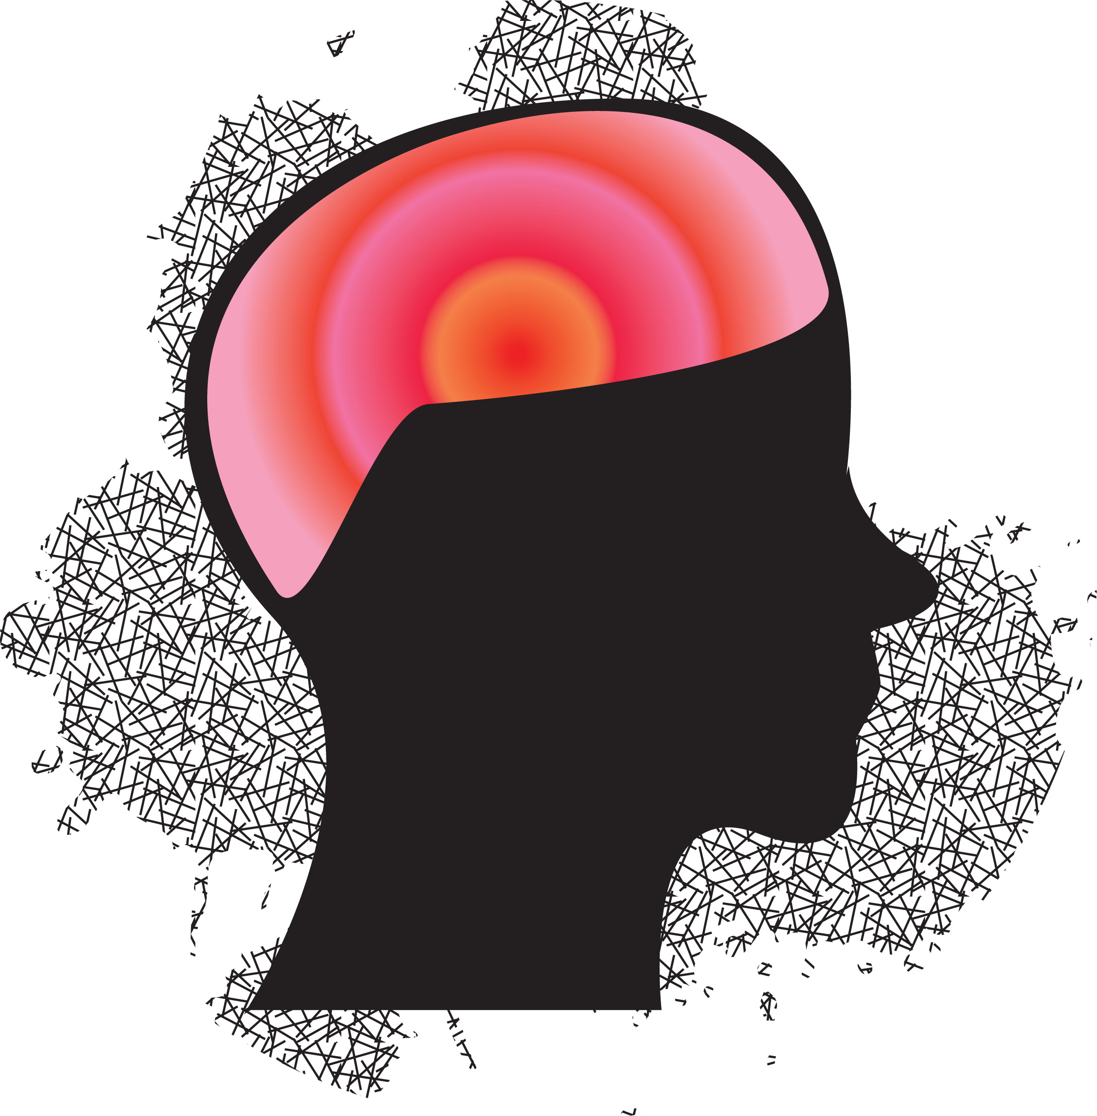
Clinical Description of Depression
Characterized by:
Depressed mood
Diminished sense of pleasure in activities
Changes in weight or sleep patterns
Can develop at any age but likelihood increases with puberty
Most common mental disorder with age
Grand Canyon University
3
Notes:
Clinical depression (for the sake of this presentation, specifically major depressive disorder) is characterized by depressed mood, which is often measured in subjective ways by the patient; this can include persistent sadness and hopeless, and/or an inability to feel joy or pleasure for all or most activities. It is common for patients to also experience insomnia or hypersomnia, weight gain or loss (typically marked by a change of more than 5 percent of body weight), agitation, mental fogginess, fatigue, and recurrent thoughts of death. Five or more symptoms merit over a two-week period merit a diagnosis (American Psychiatric Association, 2013). While a generally common diagnosis across age groups experiencing mental health issues, it is among the most common diagnosis for elder adults facing any mental health disorder (Ragan & Kane, 2010).

Slide 4
Physical Consequences of Depression
Faster physical degradation
Fatigue
Lack of movement
Can be exacerbated by or contribute to physical disability
Interrupted sleep patterns
Grand Canyon University
4
Notes:
Depression has been shown to physical alter the brain over time. There are physical causes of depression, and there are physical symptoms of depression. In fact, the issues of depression and physical pain are more closely aligned than some realize, given that both are intimately affected by serotonin and norepinephrine (Trivedi, 2004). Additionally, due to the fatigue and physical pain sometimes associated with depression, patients are less likely to maintain their physical bodies, which in turn can fuel depression. It is a cycle in that way. Kandola, et al., (2020) found that those less likely to participate in exercise are also more likely to develop a mental disorder, including depression. This is very common among elder patients, as physical disability and difficulty moving is significantly more common for this age group. Physical disability can both contribute to depression and even, in part, cause it. Depression also can negatively impact sleep, both via insomnia and through disrupted sleep patterns (American Psychological Association, 2000).

Slide 5
Emotional Consequences of Depression
Inability to feel joy or hope
Less meaning derived from relationships or motivation to pursue relationships
Grand Canyon University
5
Notes:
An inability to feel a sense of joy and hope, particularly when participating in projects or activities that would previously bring joy or hope, is a very common emotional side effect of depression (American Psychiatric Association, 2013). This lack of joy and inability to feel connection can cause some patients to retreat and isolate themselves. Unfortunately, this is often associated with a high likelihood of the depression worsening. While depression among elders is equally common among genders, uncoupled elders express higher rates of depression and suicidal ideation (Sridevi, et al., 2015). Elder patients can also struggle to motivate themselves to seek treatment and to improve their situation. It is common that elders assume that depression is natural to the end of their life and do not believe that it can be treated. This, by extension, can affect motivation and levels of hope. Depression patients of all ages are more likely to struggle with habit breaking (Byrne, et al., 2021).

Slide 6
Cognitive Consequences of Depression
Cognitive decline
Mental fogginess
Grand Canyon University
6
Notes:
As previously stated, depression is closely tied to the existence of neurotransmitters in the brain, specifically serotonin and norepinephrine (Trivedi, 2004). Historically, there have been many theories regarding depression and its exact causes, ranging from the cognitive processes in the brain to a lack of spiritual fulfillment (American Psychological Association, 2000). While there are pieces of truth in many of these theories, and causes are usually specific to each patient, a leading cause of depression is the cognitive. A lack of specific neurotransmitters can increase the likelihood of depression, resulting in feeling sad and empty; it can also increase the likelihood of physical pain. Again, there is a common (and ageist) assumption that age inherently causes depression and that grumpiness attributed to the local curmudgeon is simply age. There is nothing inherent about it, though cognitive decline can both contribute to and be caused by depression. Additionally, mental fogginess can occur as a result of depression, especially for elder patients (American Psychiatric Association, 2013).

Slide 7
Spiritual Consequences of Depression
Spiritual depletion
Less inclined to experience immediate benefits of spirituality
Grand Canyon University
7
Notes:
The issue of spirituality and the way in which it can be affected by (and affect) depression usually hinges on the patient’s conception and understanding the spirituality itself. An atheist may have a heuristic understanding of spirituality that resembles the literal consequences of physical existences, such as human relationships and connectedness. Meanwhile, a religious patient, such as a Christian, practices spirituality in a way that is closely tied to specific religious and spiritual doctrine and practices. Whatever the case may be, the ability to feel the effects associated with spirituality can be severely hindered by depression. Salman and Yee (2019) found that spiritual health is important for older adults’ overall health, especially in how it correlates with lower rates of depression and better self-perceived health. While patients are less likely to feel motivated to participate in spiritual outlets and may be less likely to feel the immediate effects of that participation (especially compared to the effects when depression has not developed), the practice must continue for the certain long-term benefits.

Slide 8
Common Forms of Abuse and Neglect
Ageism
Emotional or physical neglect
Extortion and exploitation
Grand Canyon University
8
Notes:
For elder patients, the most common forms of abuse include ageism and discrimination, emotional or physical abuse or neglect, extortion, and exploitation. The term ageism is attributed to Robert Butler, which he used to describe a combination of disparagement and discrimination directed at elder people (American Psychological Association, 2000). This can look as benign as an unfair assumption regarding aging, such as inherent mean-ness mentioned earlier. The issue, however, is that this assumption can be disastrous when it creeps into health care. The assumption that depression is inherent with age, for example, can deprive millions of elder patients of care if it is allowed to. Neglect and abuse can include verbal denunciation and demeaning comments, physical harm (such as hitting or kicking), deprivation (of medicine, food, health care, et cetera), and unnecessary and/or prolonged confinement. Any amount of this is reprehensible and merits reporting. Extortion and exploitation also exist, and this is common for family members and caretakes. Caretakers are in a position to steal directly from patients or use medicine or food as bartering chips to extort money. Even family members, particularly when one member holds a power of attorney, can exploit an elder’s resources and savings. Recourse is difficult in these cases (Steinman, et al., 2020).

Slide 9
Warning Signs
Missing belongings or money
Unexplained bruising or scarring
Unexplained emotional state
Malnutrition
Grand Canyon University
9
Notes:
The warning signs of these forms of abuse can be very obvious. For example, a credit card statement with unapproved purchases, valuable items being lost, bank accounts or investment accounts being drained, and large purchases using the credit of the elder are all common signs of exploitation. Physical abuse may present unexplained bruises and scarring, though this is sometimes hard to see, as abused may specifically avoid leaving marks or strike where a mark is less likely to be seen. Harsh reactions to physical touch is another warning sign of physical abuse. Manic or negative emotional states, particularly when unexplained by a mental health diagnosis, can suggest that emotional abuse is occurring. Malnutrition, unexplained by financial restraints or physical conditions, is a sign of neglect and possibly exploitation (Papadopoulos & La Fontaine, 2000).

Slide 10
Legal and Ethical Implications
Reporting laws (vary by municipality)
Ethical obligations
Grand Canyon University
10
Notes:
Elder abuse is, sadly, very common throughout the world. One in six elder adults throughout the world experience it (Yon, et al., 2017). To combat this, many municipalities have enacted mandatory reporting laws. These vary heavily, but some provide exemptions, for example, for healthcare workers that would ordinarily be bound by confidentiality laws. Others, such as that in Texas, require that every adults is required to report suspicions of elder abuse, extending this expectation beyond care takes and health care workers (Texas Department of Family and Protective Services, 2020). Beyond the legal requirements, however, is an ethical obligation. As outlined in the American Counseling Association (2014) Code of Ethics, counselors are expected to maintain confidentiality; however, a counselor is expected to discuss the limitations of said confidentiality. Most municipalities have mandatory reporting laws in place. While the ACA does not specifically call out elder abuse in its code of ethics, Cohen (2017) writes in the ACA’s publication, Counseling Today: “Principles that guide counseling for child abuse can also be applied to counseling for elders who have suffered financial abuse because the dynamics are very similar.” Industry professionals and legal experts can generally agree that reporting is a necessity, and mandatory reporting is a net good.

Slide 11
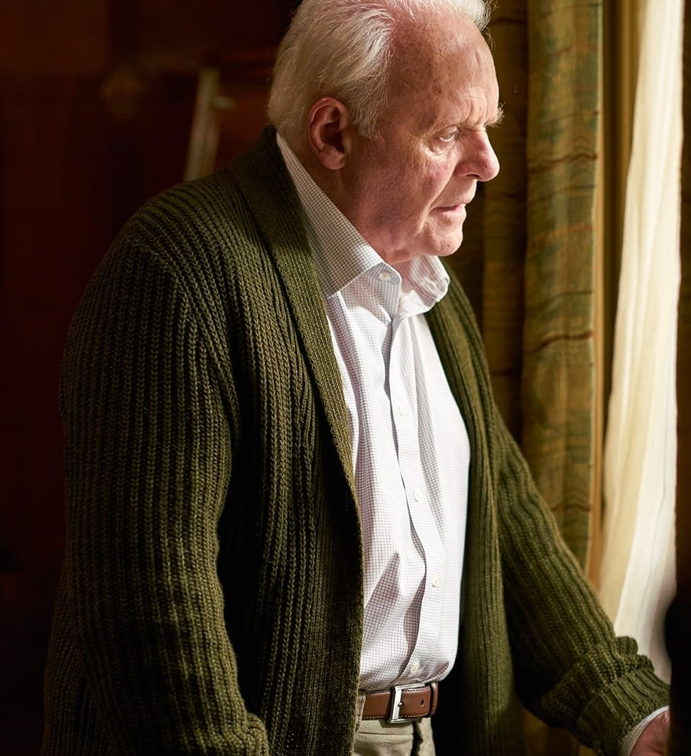
Conclusion
“I feel as if I’m losing all my leaves. The branches, and the wind, and the rain. I don’t know what’s happening anymore.”
-Anthony, as played by Anthony Hopkins (The Father, 2020)
Grand Canyon University
11
Notes:
Aging is highly complex, inevitable, troubling, joyful, saddening, necessary, and so much more. Any person who has reached maturity can look back on their life and feel a sense of gratitude and gratefulness at the way in which they learned and grew. Death itself is a sad but necessary part of life, and death cannot come to those who do not age. However, the very idea that there is such as thing as graceful or un-graceful aging should invite scrutiny. While it’s true that everyone ages differently, the way in which someone ages remains outside of human control. Use the right skin care products, exercise regularly, complete brain training activities, and still end up wrinkled and immobile by 70. And losing grasp of one’s reality, sanity, self-determination, and dignity can be horrifying. These are common sensations felt by older adults. This should invite all the empathy and encouragement that a caregiver can muster, particularly when that caregiver is specifically a counselor. In 2020’s The Father (Zeller), the viewer is left as confused and befuddled the protagonist, Anthony (played by Anthony Hopkins). The viewer is left wondering what is real and what is not; the viewer is invited to slide their feet into the Anthony’s shoes to gain even the slightest perspective of what it is like to be so hopelessly confused and, as a result, scared. These feelings are valid, but they should not be normalized as an inherent component of aging (Hurley, 2021). The dignity and worthiness of elder adults should be purported time and time again.

Slide 12
References
American Counseling Association. (2014). 2014 ACA code of ethics. https://www.counseling.org/docs/default-source/default-document-library/2014-code-of-ethics-finaladdress.pdf
American Psychiatric Association. (2013). Major Depressive Disorder. In Diagnostic and statistical manual of mental disorders (5th ed.). Washington, DC: Author.
American Psychological Association. (2000). Depression. In Encyclopedia of Psychology Vol. 2 (1st ed., pp. 471-476). Oxford University Press.
Byrne, K. A., Six, S. G., & Willis, H. C. (2021). Examining the effect of depressive symptoms on habit formation and habit-breaking. Journal of Behavior Therapy and Experimental Psychiatry, 73. https://doi-org.lopes.idm.oclc.org/10.1016/j.jbtep.2021.101676
Cohen, J. (2017, October 9). Understanding elder financial abuse. Counseling Today. Retrieved November 18, 2021, from https://ct.counseling.org/2017/04/understanding-elder-financial-abuse/.
Hurley, K. (2021). Depression in the elderly. Psycom. Retrieved November 8, 2021, from https://www.psycom.net/depression.central.elderly.html.
Kandola, A. A., Osborn, D. P. J., Stubbs, B., Choi, K. W., & Hayes, J. F. (2020). Individual and combined associations between cardiorespiratory fitness and grip strength with common mental disorders: a prospective cohort study in the UK Biobank. BMC Medicine, 18(1), 1–11. https://doi-org.lopes.idm.oclc.org/10.1186/s12916-020-01782-9
Papadopoulos, A., & La Fontaine, J. (2000). Elder Abuse : Therapeutic Perspectives in Practice: Vol. 1st ed. Speechmark Publishing Ltd.
Ragan, M., & Kane, C. F. (2010). Meaningful Lives: Elders in Treatment for Depression. Archives of Psychiatric Nursing, 24(6), 408–417. https://doi-org.lopes.idm.oclc.org/10.1016/j.apnu.2010.04.002
Salman, A., & Lee, Y.-H. (2019). Spiritual practices and effects of spiritual well-being and depression on elders’ self-perceived health. Applied Nursing Research, 48, 68–74. https://doi-org.lopes.idm.oclc.org/10.1016/j.apnr.2019.05.018
Sridevi, G., Tripathi, U. K., & Laxmi Narayana, K. (2015). Depression and suicidal ideation among elders. Journal of Psychosocial Research, 10(2), 267–276.
Steinman, B. A., Vincenti, V. B., & Yoon, S. (2020). Family dynamics and their association with elder family financial exploitation in families with appointed powers of attorney. JOURNAL OF ELDER ABUSE & NEGLECT. https://doi-org.lopes.idm.oclc.org/10.1080/08946566.2020.1823290
Texas Department of Family and Protective Services. (2020). APS Abuse Hotline - Who Should Report Abuse? Texas Department of Family and Protective Services. Retrieved November 13, 2021, from http://www.dfps.state.tx.us/Training/APS_Reporting/definitions_and_laws.asp.
Trivedi M. H. (2004). The link between depression and physical symptoms. Primary care companion to the Journal of clinical psychiatry, 6(Suppl 1), 12–16.
Yon, Y., Mikton, C. R., Gassoumis, Z. D., & Wilber, K. H. (2017). Elder abuse prevalence in community settings: a systematic review and meta-analysis. The Lancet. Global health, 5(2), e147–e156. https://doi.org/10.1016/S2214-109X(17)30006-2
Zeller, F (Director). (2020). The Father [Film]. F comme Film.
Grand Canyon University
12

