Slide 1
Sexual Disorders Dylan Schouppe Grand Canyon University CNL-530-0500 Marcie Burger October 27, 2021
Grand Canyon University

Slide 2
Objectives
Establish distinction between sexual dysfunction disorder and paraphilic disorder
Describe Male Hypoactive Sexual Desire Disorder and discuss treatment methods
Describe Voyeuristic Disorder and discuss treatment methods
Grand Canyon University
2

Slide 3
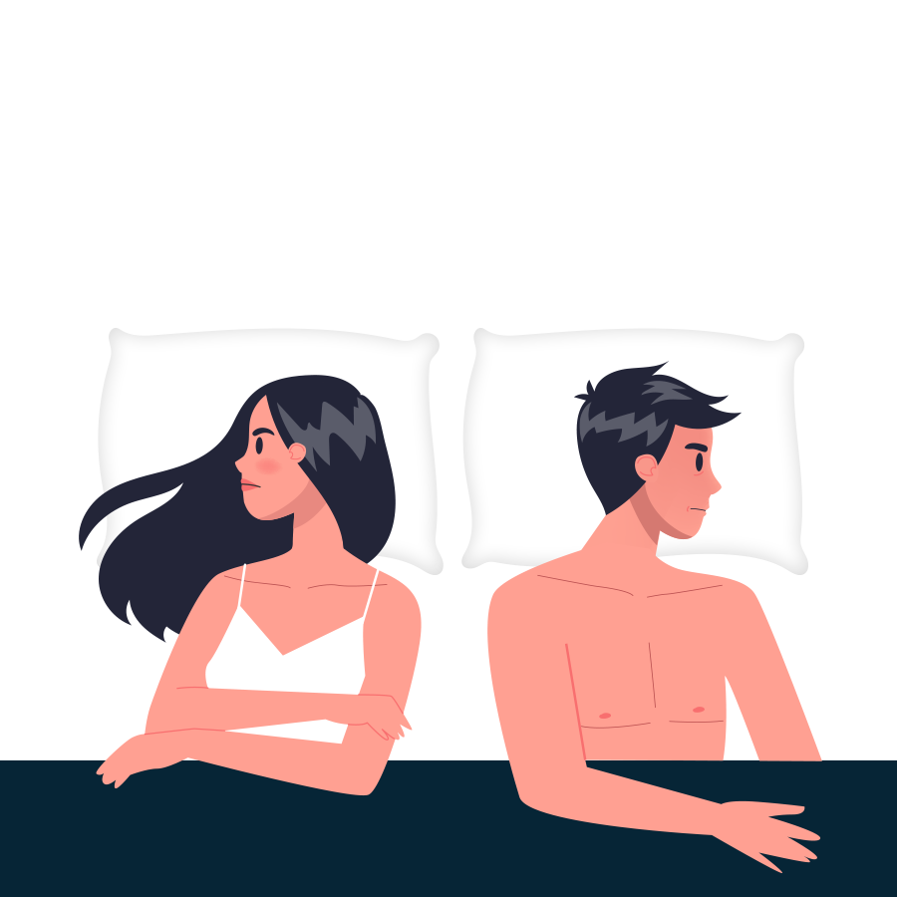
Sexual Dysfunction Disorder
Characterized by significant disturbance in sexual experience
Can exist as lifelong or temporary
disorders
Several possible causes
Biological
Psychological
Social
Grand Canyon University
3
Notes:
A sexual dysfunction disorder is defined by the Diagnostic and Statistical Manual as …” heterogeneous group of disorders that are typically characterized by a clinically significant disturbance in a person's ability to respond sexually or to experience sexual pleasure” (American Psychological Association, 2013, p. 423). Multiple disorders can be diagnosed simultaneously; however, if the sexual dysfunction is the result of another mental disorder, such as depression, the patient would receive the singular diagnosis. Sexual dysfunction disorders can be lifelong in some patients, manifesting during a patient’s first sexual experiences. Alternatively, they could be acquired, which infers that the disorder is developed following a period of normalcy in their sex life. They may also be generalized, referring to sexual difficulty that exists regardless of the circumstances of the sexual encounter, or situational, referring to sexual difficulty only in specific circumstances. There are three broad causes of sexual dysfunction: biological, psychological, and social. These causes can exist concurrently and singularly.

Slide 4
Paraphilic Disorder
Characterized by intense and persistent sexual interest in activity that does not involve genital stimulation or fondling
Classified in two groups
Anomalous activity preferences
Anomalous target preferences
Erotic activities and erotic targets
Grand Canyon University
4
Notes:
Paraphilic disorders are characterized by the Diagnostic and Statistical Manual as denoting “… intense and persistent sexual interest other than sexual interest in genital stimulation or preparatory fondling with phenotypically normal, physically mature, consenting human partners” (American Psychological Association, 2013, p. 685). The DSM does not include an exhaustive list of paraphilic disorders and encourages the use of diagnostic criteria to consider other disorders. These disorders specifically are included because they are among the most common paraphilic disorders, and in some cases, may result in criminal activity. Consider the classification of these disorders into two groups: anomalous activity preferences, and anomalous target preferences. The former refers to activities for which the patient may have preference; this is subdivided into two groups, courtship disorders (referring to distorted components of human bonding) and algolagnic disorders (referring to pain and suffering). The latter refers to the targets of the disorders for which the patient may have a preference; this includes pedophilia and fetishistic disorders.

Slide 5
Male Hypoactive Sexual Desire Disorder
Diagnostic criteria (condensed):
Persistent reoccurring deficiency or absence of sexual interest
Not caused by other sexual factors
Consider other circumstantial factors
Grand Canyon University
5
Notes:
Male Hypoactive Sexual Desire Disorder (HSDD) is a common sexual dysfunction disorder that is indicative of a persistent and/or reoccurring deficiency or absence sexual thoughts and/or desire. Deficiency is, of course, vague, which allows the clinician and the patient to determine what can be considered deficient. The symptoms should have lasted for longer than six months and be a cause of psychological distress to meet the diagnostic criteria, though a judgment call can be made otherwise. The clinician should also consider other factors, including other mental disorders and life circumstances of the patient that may be contributing to this, such as quality of the relationship that the patient belongs to or other adaptive responses. It’s a common comorbidity of depression. There is a significant level of stigma attached to this disorder, as there is a unfortunate social stereotype suggesting that men are always (and even should be) sexually interested (Montgomery, 2008).

Slide 6
Treating Male Hypoactive Sexual Desire Disorder
Therapy
Cognitive behavioral therapy
Sex-positive oriented sex therapy
Pharmacology
Androgen supplementation
Grand Canyon University
6
Notes:
Male HSDD can be successfully treated a number of ways. First, there is the treatment via cognitive behavioral therapy. Sexual desire can be heavily affected by unconscious trauma, confusion, or internal conflict; CBT can help a patient address these, which may relieve or eliminate HSDD. Additionally, sex positive sex therapy and mindfulness therapy may also improve symptoms Kimmes, et al., 2015). This creates a healthier worldview regarding sex and can improve a couple sexual connection. Alternatively, or concurrently, a patient can be treated pharmaceutically. A common cause for HSDD in men is androgren deficiency. This can be successfully treated in some case with androgen supplementation, though, as with all medications, there are risks and other factors to consider (Bhasin & Basson, 2016).

Slide 7
Voyeuristic Disorder
Diagnostic criteria (condensed):
Recurrent and intense sexual desire from observing unsuspecting person or persons naked or engaged in sexual contact
Arousal has been acted on with nonconsenting person or persons
Can be applied to those who admit sexual interest and to those that deny in the face of substantial evidence
Recurrent spying of at least three individuals is guideline
Grand Canyon University
7
Notes:
The presence of voyeuristic disorder is evidenced by “recurrent and intense sexual arousal from observing an unsuspecting person who is naked, in the process of disrobing, or engaging in sexual activity, as manifested by fantasies, urges, or behaviors” (p. 686), the acting on of this sexual arousal by the patient, and the target of the arousal is at least 18 years of age (American Psychological Association, 2013). The nature of the criminality of this act depends on the circumstances, especially of the municipality in which this occurs. Different jurisdictions may have their own laws regarding voyeurism. The diagnosability of this disorder differs from the straightforward self-reporting that is often paired with sexual disorders. If a patient reports psychological distress from their voyeurism, this usually merits a diagnosis of voyeuristic disorder. However, a patient can deny any sexual interest, or deny that their interest should be considered a disorder and can still be diagnosed with voyeuristic disorder in the face of significant evidence (for example, the patient was arrested multiple times for trespassing in a locker room of a different gender). Generally a diagnostic threshold recommends that recurring spying be defined as three or more time, but this guideline can be overlooked based on the judgment of the clinician or the judgment of the patient. Balon (2016) and Janssen (2018) argues that the DSM unfairly and unclearly defines voyeuristic disorder and establishes a poorly-informed victimological standpoint, one that can easily be hijacked by vice police. Morality aside, the ethics and legality of voyeurism may not seriously consider the concept of consent exhaustively enough.

Slide 8
Treating Voyeuristic Disorder
Therapy
Cognitive Behavioral Therapy
Group therapy
Pharmacology
Grand Canyon University
8
Notes:
Voyeuristic disorder can be difficult to treat because sexuality is difficult to control and the nature of labeling a sexual urge or a sexual attraction as a disorder may be rejected by those suffering from it. CBT can be implemented to explore the inner, unconscious conflicts and pathologies that may be contributing to this attraction. For example, voyeurism may be contributed to by an unconscious desire to remain unseen, the pleasure associated with being unseen, or the control that can be associated with being unseen. Group therapy can expand upon this and build on an understanding of boundaries and respect for other people. Additionally, medication can be implemented to help control urges and reduce impulsive behaviors. This can allow the kind of clarity in the mind of the patient to consider, in the moment of choosing whether or not to engage is voyeurism, that which is discussed in CBT and group therapy sessions.

Slide 9
Conclusion
“What a kid I got. I told him about the birds and the bees, and he told me about the butcher and my wife.”
-Rodney Dangerfield
Grand Canyon University
9
Notes:
Sex and sexuality are the brunt of countless jokes and are staples of popular culture. This is because sexuality is a universal experience that every human can relate to and understand. That’s part of what makes the above quote from Dangerfield (2020) so hilarious. It’s also precisely this reason that sexual dysfunction disorders and coercive and victimizing are no laughing matter, since they can prevent a person from enjoying the sexual experience, the quintessential human experience, to its greatest extent.

Slide 10
References
American Psychiatric Association. (2013). Diagnostic and statistical manual of mental disorders (5th ed.). Washington, DC: Author.
Balon, R. (2016). Lack of clarity in the DSM-5 criteria of voyeuristic disorder. Journal of Sex & Marital Therapy, 42(5), 391–392. https://doi-org.lopes.idm.oclc.org/10.1080/0092623X.2016.1158760
Balon, R. (2016). Voyeuristic Disorder. In R. Balon (Ed.), Practical Guide to Paraphilia and Paraphilic Disorders (pp. 63-75). Springer International Publishing. https://link.springer.com/chapter/10.1007/978-3-319-42650-1_5#citeas
Bhasin, S., & Basson, R. (2016). Chapter 20 - Sexual Dysfunction in Men and Women. In S. Melmed, K. S. Polonsky, P. R. Larsen & H. M. Kronenberg (Eds.), Williams Textbook of Endocrinology (Thirteenth Edition) (pp. 785-830). Elsevier. https://doi.org/10.1016/B978-0-323-29738-7.00020-4
Dangerfield, R. (2020). Rodney Dangerfield's Top 10 Jokes About His Kids. [Video]. YouTube. https://www.youtube.com/watch?v=HKfjXHxu_0g
Janssen, D. F. (2018). “Voyeuristic Disorder”: Etymological and Historical Note. Archives of Sexual Behavior, 47(5), 1307. https://doi-org.lopes.idm.oclc.org/10.1007/s10508-018-1199-2
Kimmes, J. G., Mallory, A. B., Cameron, C., & Köse, Ö. (2015). A treatment model for anxiety-related sexual dysfunctions using mindfulness meditation within a sex-positive framework. Sexual and Relationship Therapy, 30(2), 286–296. https://doi-org.lopes.idm.oclc.org/10.1080/14681994.2015.1013023
Montgomery K. A. (2008). Sexual desire disorders. Psychiatry (Edgmont (Pa. : Township)), 5(6), 50–55. https://www.ncbi.nlm.nih.gov/pmc/articles/PMC2695750/
Grand Canyon University
10

